Slide 1
Rezultati fluxov
Pipeline analogen log2TPM

Slide 2
Top 10 podsistemov (human1) glede na normalizirano distanco
Fluxi:
-1 471 reakcij:
Pentose phosphate pathway
Glycolysis / Gluconeogenesis
Pyrimidine metabolism
Pentose and glucuronate interconversions
Arginine and proline metabolism
Exchange/demand reactions
Alanine, aspartate and glutamate metabolism
Miscellaneous
Glycine, serine and threonine metabolism
Tricarboxylic acid cycle and glyoxylate/dicarboxylate metabolism
Log2(TPM):
-352 genov:
Starch and sucrose metabolism
Protein modification
Retinol metabolism
Vitamin A metabolism
Miscellaneous
Acylglycerides metabolism
Protein degradation
Ascorbate and aldarate metabolism
Protein assembly
Formation and hydrolysis of cholesterol esters

Slide 3
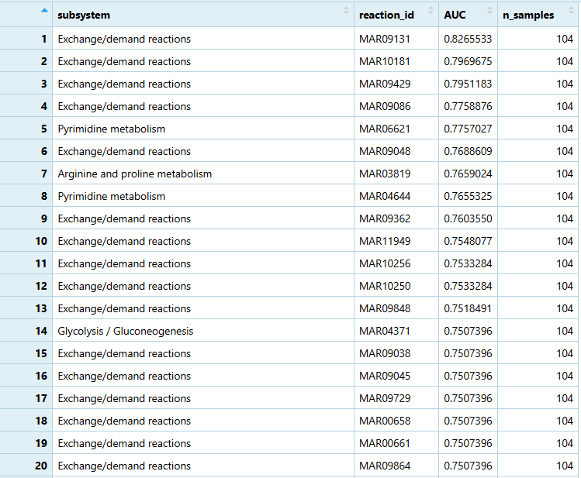
Top 10 podsistemov

Slide 4
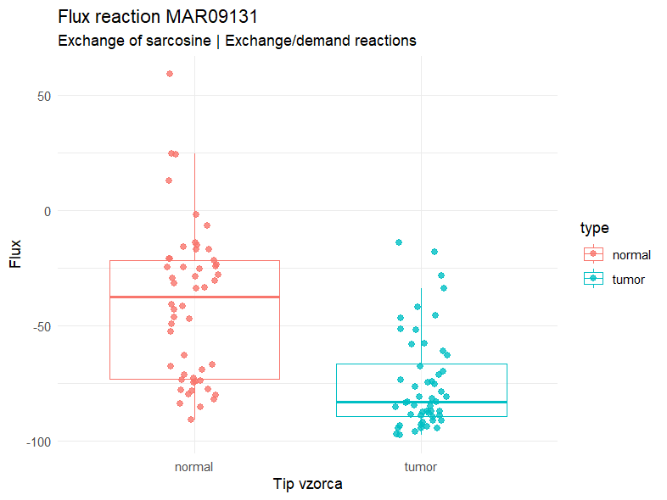
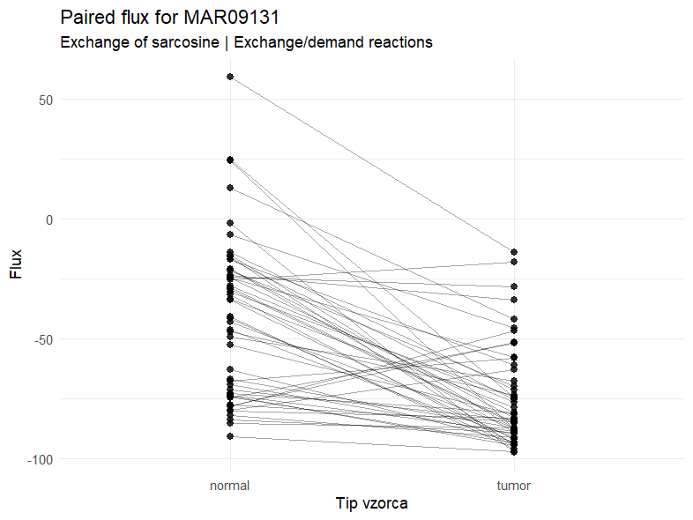

Slide 5
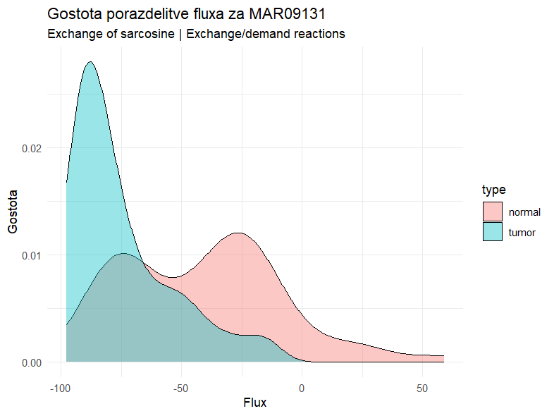
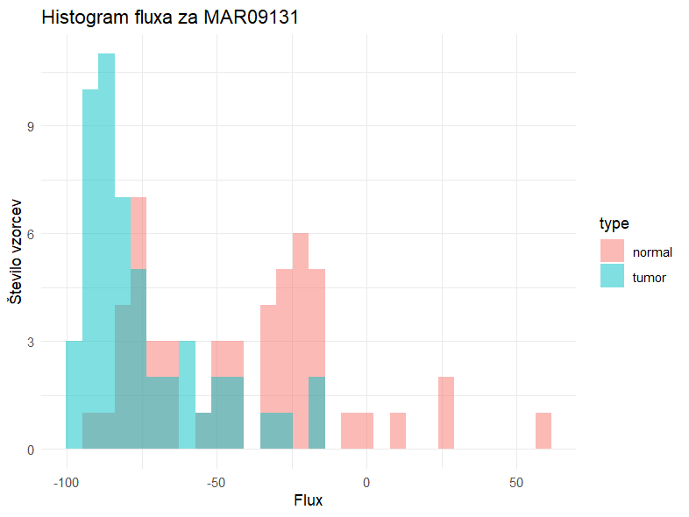

Slide 6
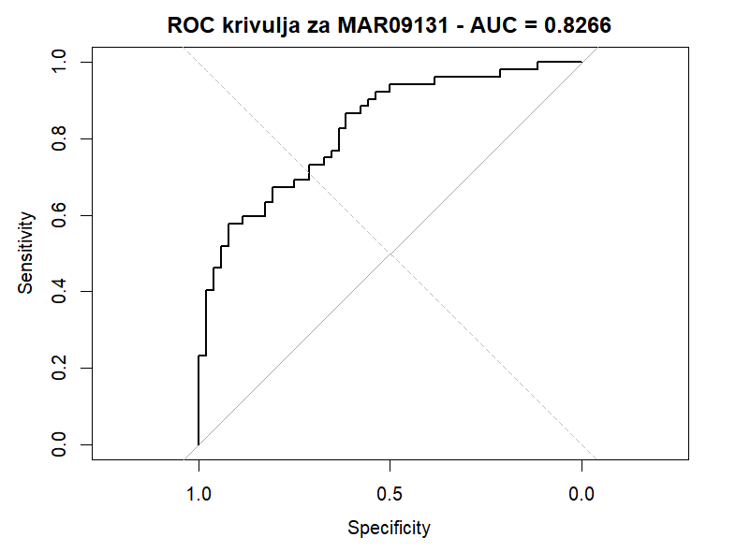
AUC=0,8266

Slide 7
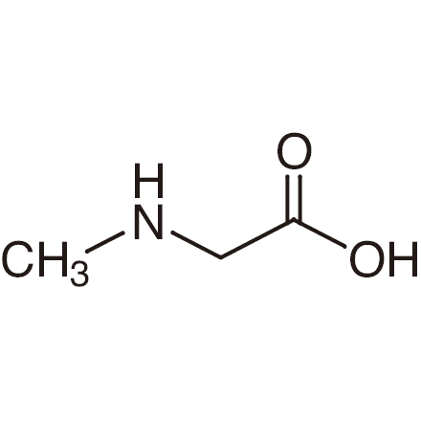
MAR09131, Exchange of sarcosine
!!!
Izmenjava sarkozina/N-metilglicina med celico in okolic
Tumorska celica glede na ftINIT mora prevzeti več sarkonina kot pa normalne celice
Glavne funkcije: donor metilne skupine (sinteza nukleotidov in metilacija biomolekul), modulator/regulator transporta nevrotransmiterjev (inhibitor glicinskega transporterja GlyT1)
Literatura razdvojena glede sarkozina kot marker za raka prostate pri urinski analizi
(https://www.sciencedirect.com/science/article/pii/S030228381000182X?via%3Dihub)
HUMAN1 nima asociranega gena s to reakcijo, spada pa v podsistem Exchange/demand reactions -> ni mogoče direktno primerjati z rezultati DESeq2 in log2TPM

Slide 8
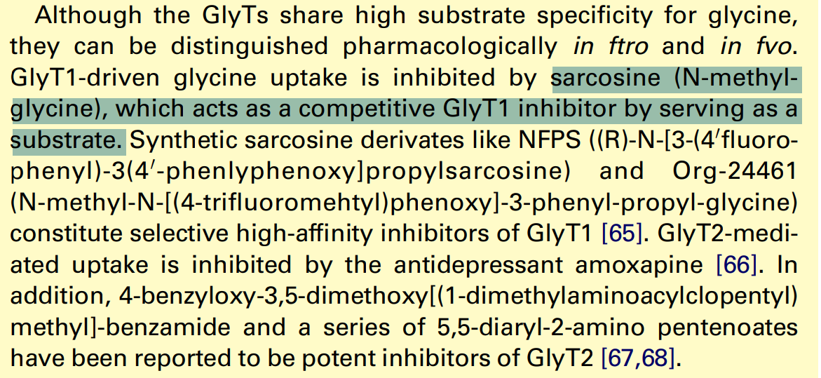
Posredna povezava AUC fluxov z DESeq2 in log2TPM-transporterji
https://www.sciencedirect.com/science/article/pii/S0968000405000940?via%3Dihub
Nisem našel študij, ki bi eksplicitno dokazale, da GlyT(glicinski transporterji) transportirajo sarkozin
ENSG00000196517, Glyt1- značilen glicinski transporter
ENSG00000105711, GlyT2
ENSG00000137210, PAT1
ENSG00000105281, Alanine-serine-cysteine transporter (ASCT2)
Transport nevtralnih aminokislin (preferenca Glu)

Slide 9
Posredna povezava AUC fluxov z DESeq2 in log2TPM-metabolizem
Razgradnja sarkozina v glicin
Ni v human1
Nastanek sarkozina/metilacija glicina
Ni v human1
Demetilacija dimetilglicina/nastanek sarkozina
Nisem našel povezave med difierencialno izraženimi geni (DESeq2), metabolnimi geni (log2TPM) in reakcijo (fluxi) -> zato se bom držal le tistih asociiranih genov v human1

Slide 10
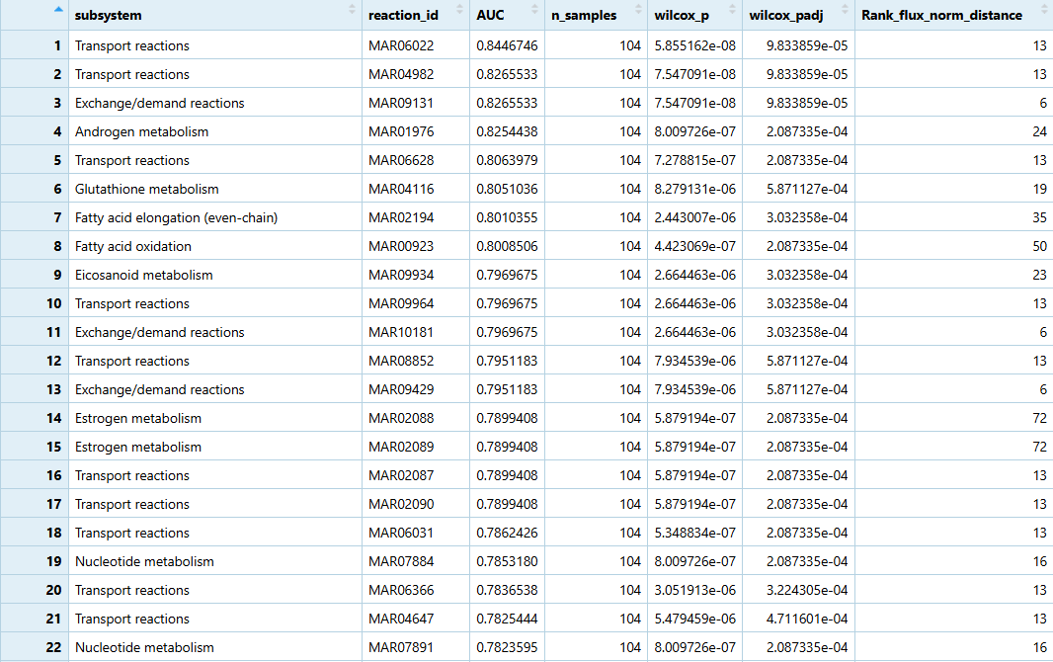
Vsi podsistemi

Slide 11
